Slide 1
Angle Modulation

Slide 2



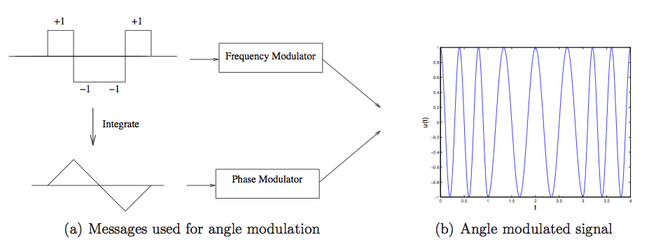
Angle Modulation
Phase modulation with integral
of message
FM/PM equivalence

Slide 3
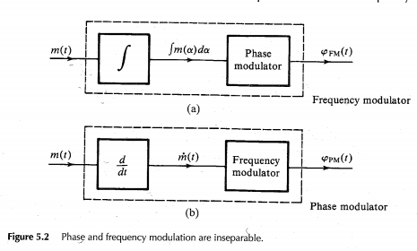

Slide 4
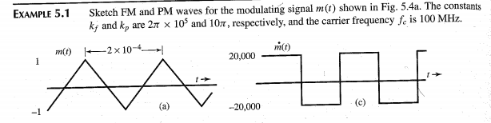
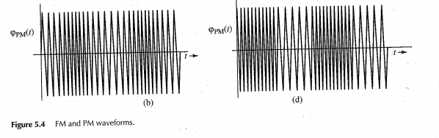

Slide 5
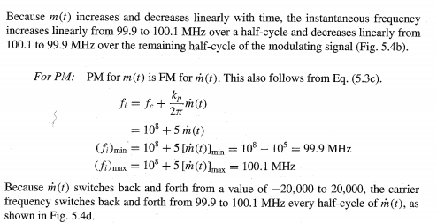

Slide 6
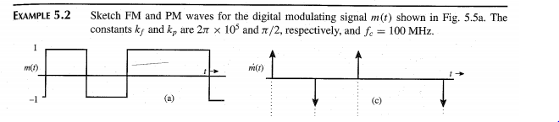
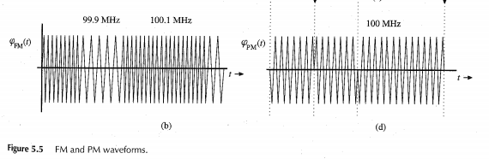

Slide 7

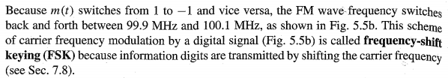

Slide 8
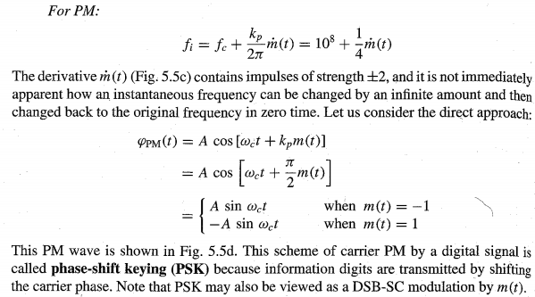
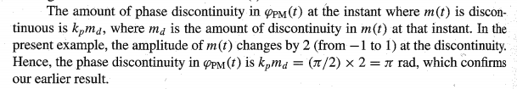

Slide 9
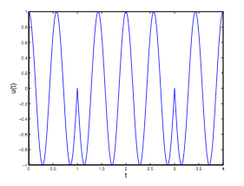
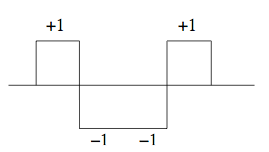
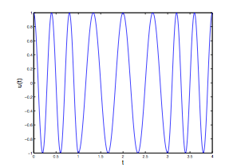
PM vs FM
PM
(PSK for digital
messages)
Digital message
Discontinuous phase ➔ vulnerable to nonlinearities,
poorer frequency containment
Continuous phase ➔ more robust to nonlinearities,
better frequency containment
FM

Slide 10
PM versus FM in practice
Legacy analog communication ➔ no control over message signal ➔ FM preferred
Integration of message prior to phase modulation leads to smooth phase, better bandwidth containment
Digital communication ➔ can design message signal ➔ PM (or PSK) often preferred
Easier to implement optimal demodulator
Use bandwidth-efficient pulses rather than rectangular pulses to create smoother signals with better frequency containment
2G GSM cellular used Gaussian MSK, a form of FM), but optimal demodulation more complicated

Slide 11
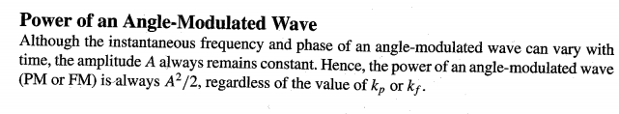

Slide 12


FM basics
Frequency deviation
Modulation index
We use the term narrowband FM if β < 1 (typically much smaller than one), and the term wideband FM if β > 1.

Slide 13
FM spectrum: Bandwidth
Narrowband FM
Similar to DSB
Bandwidth = 2B (where B=message bandwidth)
Wideband FM
Bandwidth dominated by max frequency deviation
Carson’s formula: adds the two components

Slide 14
Narrowband FM
Consider an angle modulated signal, u_{p}(t) = A_{c} cos (2πf_{c}t + θ(t)), where θ(t) contains the message information. For a baseband message m(t) of bandwidth B, the phase θ(t) for PM is also a baseband signal with the same bandwidth.
The phase θ(t) for FM is the integral of the message. Since integration smooths out the time domain signal, attenuates higher frequencies, θ(t) is a baseband signal with bandwidth at most B. θ(t) is assumed to having a bandwidth equal to B, the message bandwidth.
The complex envelope of up with respect to f_{c} is given by
u(t) = A_{c}e^{jθ(t)} = A_{c} cos θ(t) + jA_{c}sin θ(t)
If |θ(t)| is small, as is the case for narrowband angle modulation, then
cos θ(t) ≈ 1 and sin θ(t) ≈ θ(t),
u(t) ≈ A_{c} + jA_{c}θ(t)

Slide 15





Narrowband FM
(similar to AM, except message-dependent term is in the Q component)
Phase deviation proportional to integral of message
➔ Bandwidth about the same as (or less than) that of message
➔ Bandwidth of narrowband FM about 2B (B=message bandwidth)

Slide 16
Narrowband FM
The bandwidth of a narrowband FM signal is 2B, or twice the message bandwidth, just as in AM.
For example, narrowband angle modulation with a sinusoidal message m(t) = cos 2πf_{m}t occupies a bandwidth of 2f_{m}:
θ(t) = k_{f}/f_{m}sin 2πf_{m}t for FM, and
θ(t) = k_{p} cos 2πf_{m}t for PM.

Slide 17
Wideband FM
For wideband FM, we would expect the bandwidth to be dominated by the frequency deviation kf_{m}(t). For messages that have positive and negative peaks of similar size, the frequency deviation ranges between −f_{max} and f_{max}, where f_{max} = k_{f}max_{t}|m(t)|.
The bandwidth will be dominated by the instantaneous deviations around the carrier frequency, which spans an interval of length 2f_{max}.

Slide 18


Wideband FM
Bandwidth dominated by frequency deviation
swings between
(assuming equal positive and negative swings in message)
Carson’s rule: add up estimates for narrowband and wideband FM
FM modulation index or deviation ratio

Slide 19
FM spectrum for periodic messages
Complex envelope is periodic for periodic messages ➔ Fourier series
Spectrum of complex envelope is discrete, with impulses at integer multiples of fundamental freq
Standard example: sinusoidal message
But approach is quite general
Somewhat artificial, since most messages are not periodic

Slide 20


FM spectrum for sinusoidal message
Complex envelope for sinusoidal message
Periodic ➔ can express in terms of Fourier series

Slide 21


FM spectrum for sinusoidal message
Computation of Fourier coefficients
Change of variables and simplification ➔
Bessel function of first kind
(order n)

Slide 22
Bessel function properties
Let’s show that this is
actually real-valued
(even term survives)
(odd term integrates to zero)

Slide 25
Bessel Function Properties
For integer n, J_{n}(β) = (−1)^{n}J_{−n}(β) = (−1)^{n}J_{n}(−β).
For fixed β, J_{n}(β) tends to zero as n gets large, so that the complex envelope is well approximated by a finite number of Fourier series components.
In particular, a good approximation is that
J_{n}(β) is small for |n| > β + 1.
This leads to an approximation for the bandwidth of the FM signal given by 2(β + 1)f_{m}, which is consistent with Carson’s rule.
For fixed n, J_{n}(β) vanishes for specific values of β, a fact that can be used for spectral shaping.

Slide 26
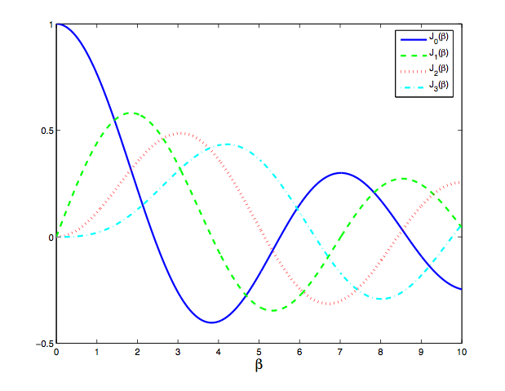
Bessel function plots

Slide 27
FM Spectrum

Slide 28


Fractional power containment BW
Power = sum of magnitude squared of Fourier series coefficients
we can compute the fractional power containment bandwidth as 2Kf_{m}, where K ≥ 1 is the
smaller integer such that,
where α is the desired fraction of power within the band. (e.g., α = 0.99 for the 99% power
containment bandwidth). For integer values of β = 1, ..., 10, we find that K = β + 1 provides a
good approximation to the 99% power containment bandwidth, which is again consistent with
Carson’s formula.

Slide 29
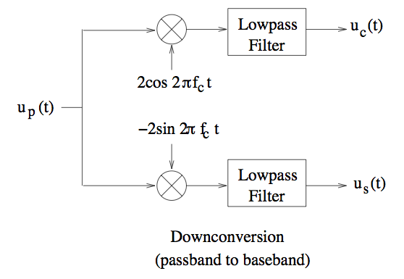
Down-conversion
--Direct conversion (mixing down to baseband) can suffer from LO leakage to
mixer input ➔ DC component that can swamp later circuit components
--Difficult to provide large gains at high carrier frequencies
Superhet architecture uses multiple stages of mixing to alleviate these problems

Slide 30
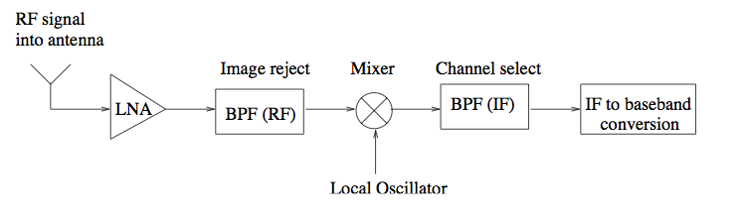
Superheterodyne Receiver
Sloppy RF filtering, followed by careful filtering at fixed IF, followed by
IF to baseband conversion
RF front end often made tunable (e.g., multiple bands in WiFi and cellular,
multiple stations in AM or FM)

Slide 31
AM and FM Radio
The superhet architecture is commonly employed for AM and FM broadcast radio receivers, where the RF front end tunes to the desired station, translating the received signal to a fixed IF. Radio receivers built with discrete components often take advantage of the widespread availability of inexpensive filters at certain commonly used IF frequencies, such as 455 KHz (used for AM radio) and 10.7 MHz (used for FM radio).

Slide 32
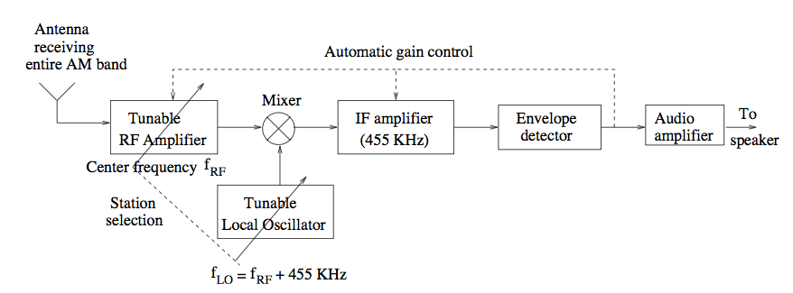
Example: superhet for AM radio

Slide 33
AM Receiver
Two frequencies from mixing with LO: which to set as IF?
Example for AM radio: RF freq ranges from 540 to 1600 KHz.
f_{IF} = 455 KHz.
f_{LO} = f_{RF} + f_{IF} ➔ LO freq ranges from 995 to 2055 KHz (preferred)
f_{LO} = f_{RF} – f_{IF} ➔ LO freq ranges from 85 to 1145 KHz (huge variation in tuning range)

Slide 34
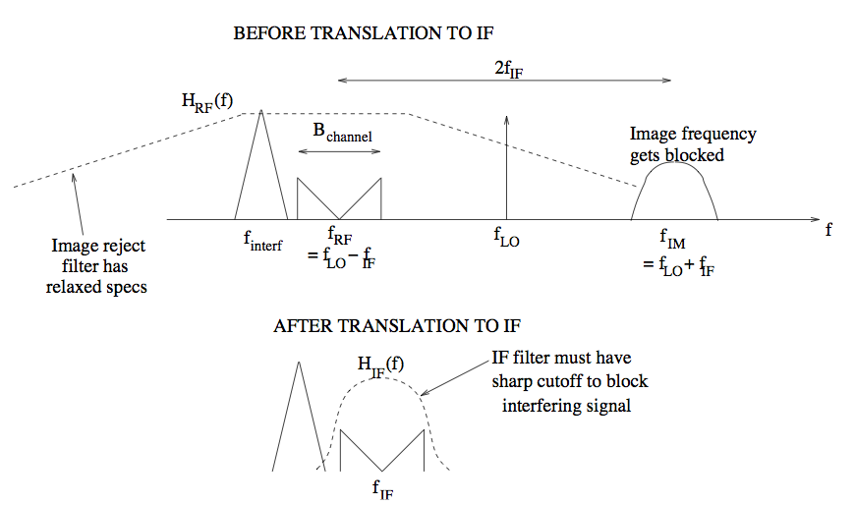
Superhet: freq domain operations

Slide 35
Superhet
Having fixed the LO frequency, we have a desired signal at f_{RF} = f_{LO} − f_{IF} that leads to a component at IF, and potentially an undesired image frequency at f_{IM} = f_{LO}+f_{IF} = f_{RF} +2f_{IF} that also leads to a component at IF.
The job of the RF bandpass filter is to block this image frequency. Thus, the filter must let in the desired signal at f_{RF} (so that its bandwidth must be larger than 10 KHz), but severely attenuate the image frequency which is 910 KHz away from the center frequency. It is therefore termed an image reject filter.
For the AM broadcast radio application, a superhet architecture allows us to design the tunable image reject filter to somewhat relaxed specifications. The IF filter, which is tuned to the fixed frequency of 455 KHz, filters out the adjacent stations using a highly selective filter at IF with a bandwidth of 10 KHz.

Slide 36
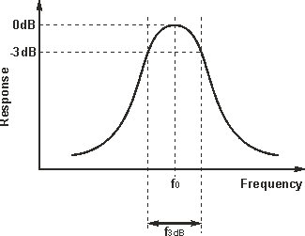

Q factor of the Filter

Slide 37
Problems for practice
3.6, 3.7, 3.9 (Skip VSB part), 3.16

Slide 38




FM basics
Example: Sinusoidal message

Slide 39
FM Modulation
An FM modulator, by definition, is a Voltage Controlled Oscillator (VCO), whose output is a sinusoidal wave whose instantaneous frequency offset from a reference frequency is proportional to the input signal.
VCO implementations are often based on the use of varactor diodes, which provide voltage-controlled capacitance, in LC tuned circuits. This is termed direct FM modulation, in that the output of the VCO produces a pass-band signal with the desired frequency deviation as a function of the message.
The VCO output may be at the desired carrier frequency, or at an intermediate frequency. In the latter scenario, it must be up-converted further to the carrier frequency.

Slide 40
FM Demodulator
The task of an FM demodulator is to convert frequency variations in the pass-band received signal into amplitude variations, thus recovering an estimate of the message.
FM demodulator would produce the derivative of the phase of the received signal; this is termed a discriminator. While an ideal FM signal does not have amplitude fluctuations, noise and channel distortions might create such fluctuations, which leads to unwanted contributions to the discriminator output.

Slide 41
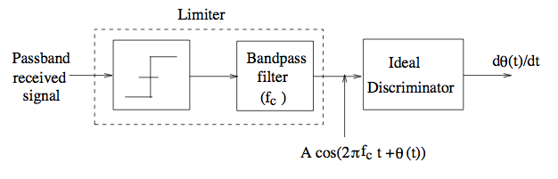
Limiter-Discriminator
Enforces constant envelope
Takes derivative

Slide 42
FM Demodulator
In practice, the discriminator is typically preceded by a limiter, which removes amplitude fluctuations due to noise and channel distortions.
This is achieved by passing the modulated sinusoidal waveform through a hard-limiter, which generates a square wave, and then selecting the right harmonic using a band-pass filter tuned to the carrier frequency. The overall structure is termed a limiter-discriminator.

Slide 43
Limiter-Discriminator
Following the limiter, we have an FM signal of the form:
y_{p}(t) = Acos(2πf_{c}t + θ(t))
where θ(t) may include contributions due to channel and noise impairments, as well as the angle modulation due to the message. An ideal discriminator now produces the output dθ(t)/dt.

Slide 44
Discriminator

Slide 45

Why it works
FM Signal
Derivative of FM signal
d/dt

Slide 46
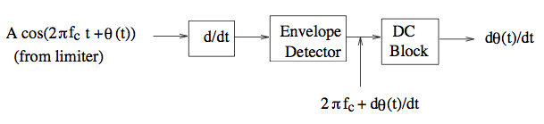
Why it works
Envelope of derivative contains message (plus DC)
Max frequency deviation smaller than carrier frequency for well-designed system

Slide 47
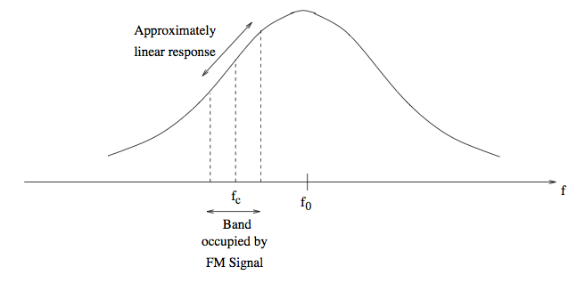
Approximate differentiation
Can use linear slope region of filter response
Can do better with baseband implementation

Slide 48
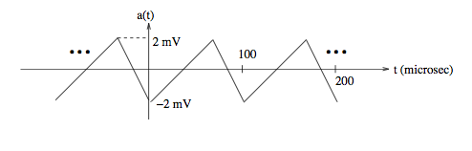
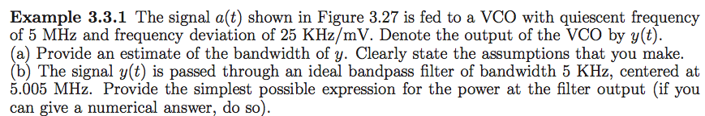
Example 3.3.1

Slide 49
Example
The VCO output is an FM signal with
f_{max} = k_{f}max_{t}m(t) = 25 KHz/mV × 2 mV = 50 KHz
The message is periodic with period 100 microseconds, hence its fundamental frequency is 10 KHz. Approximating its bandwidth by its first three harmonics, we have B ≈ 30 KHz.
Using Carson’s formula, we can approximate the bandwidth of the FM signal at the VCO output as B_{FM} ≈ 2f_{max} + 2B ≈ 160 KHz

Slide 50
Example
The complex envelope of the VCO output is given by e^{jθ(t)} where
Complex envelope can be expressed as a Fourier series with complex exponentials at frequencies nf_{m}, where f_{m} = 10 KHz is the fundamental frequency for the message, and where n takes integer values. Thus, the FM signal has discrete components at f_{c} + nf_{m}, where f_{c} = 5 MHz in this example.
A bandpass filter at 5.005 MHz with bandwidth 5 KHz does not capture any of these components, since it spans the interval [5.0025, 5.0075] MHz, whereas the nearest Fourier components are at 5 MHz and 5.01 MHz. Thus, the power at the output of the bandpass filter is zero.

Slide 51
Example

